Slide 1


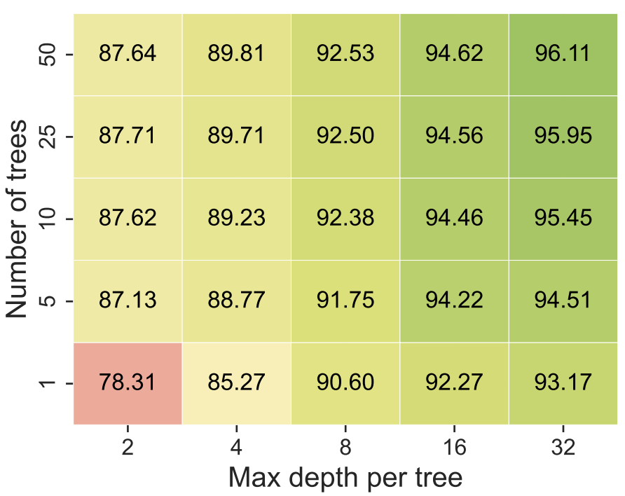
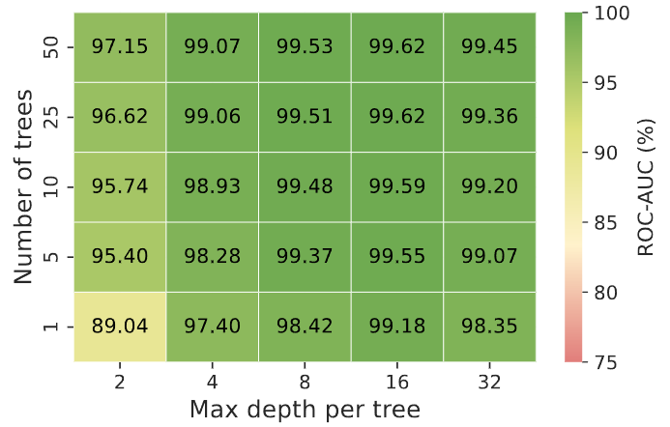
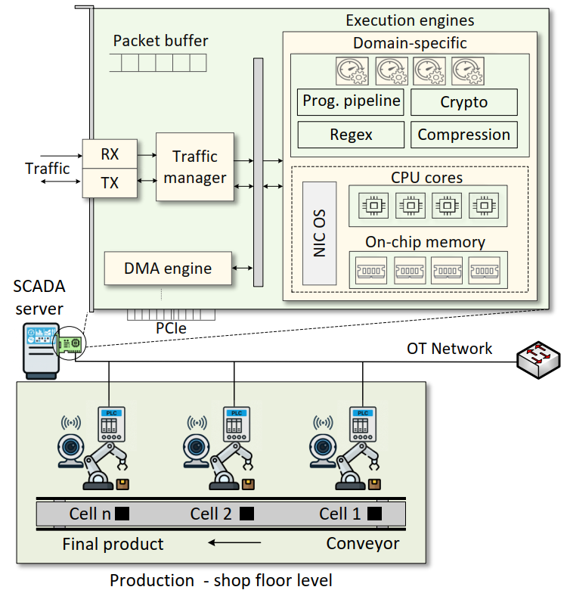
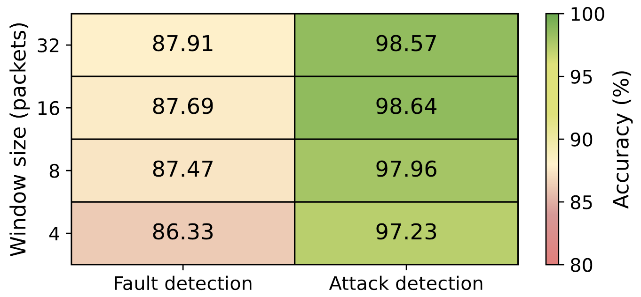
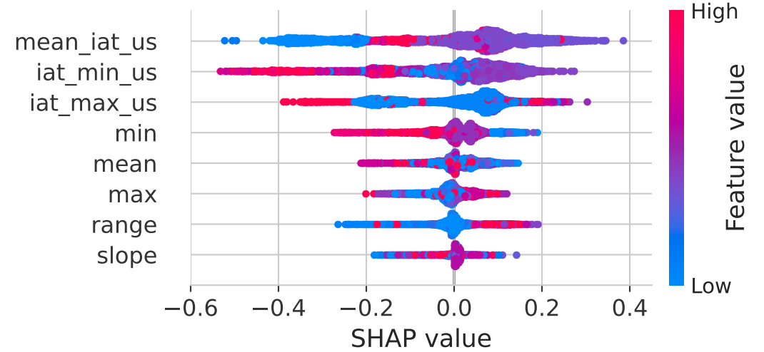
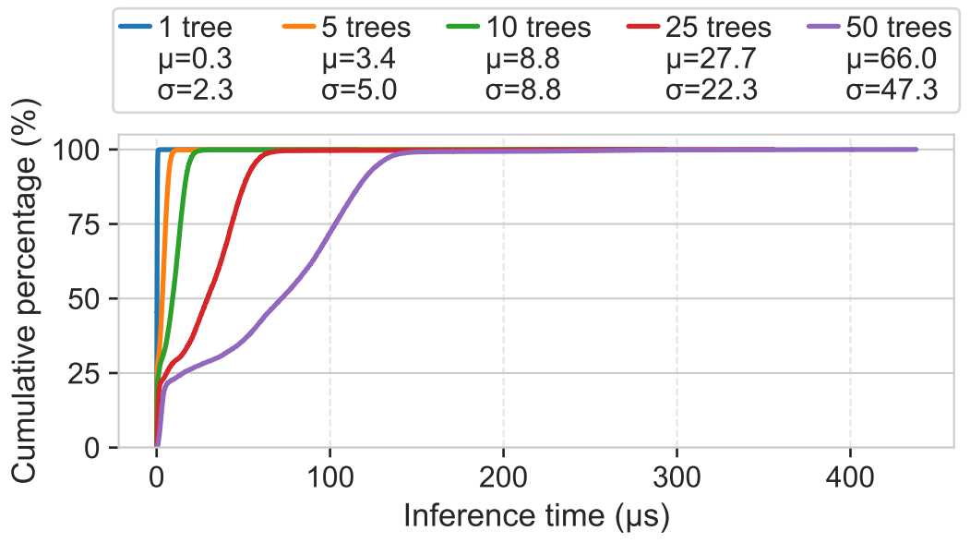
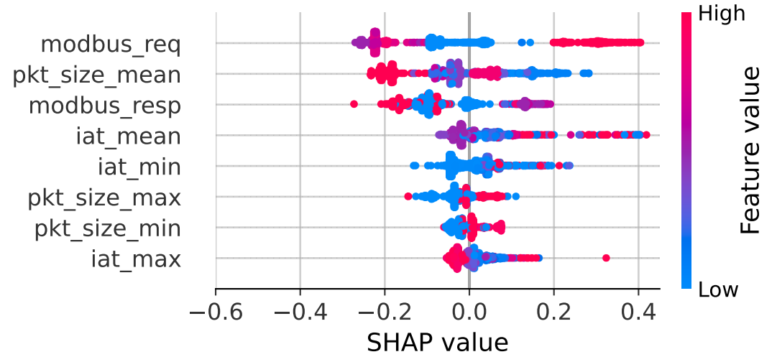
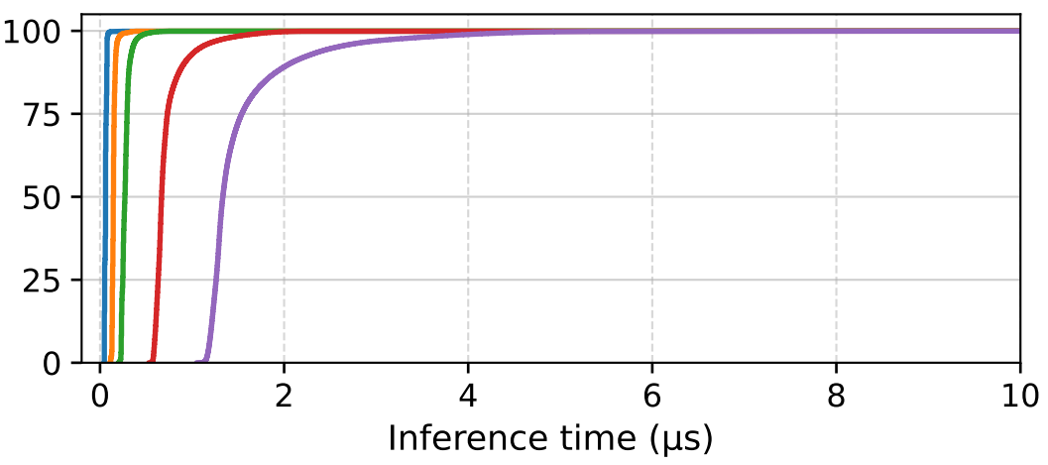
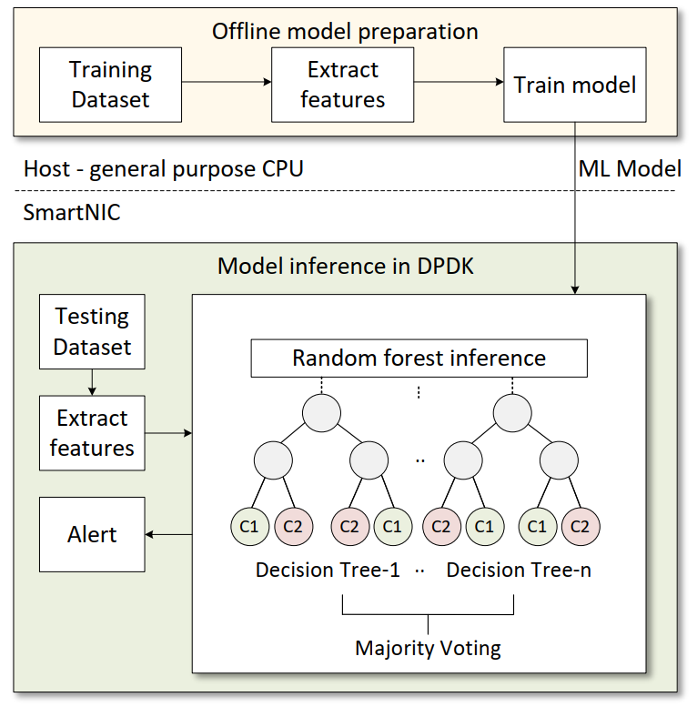
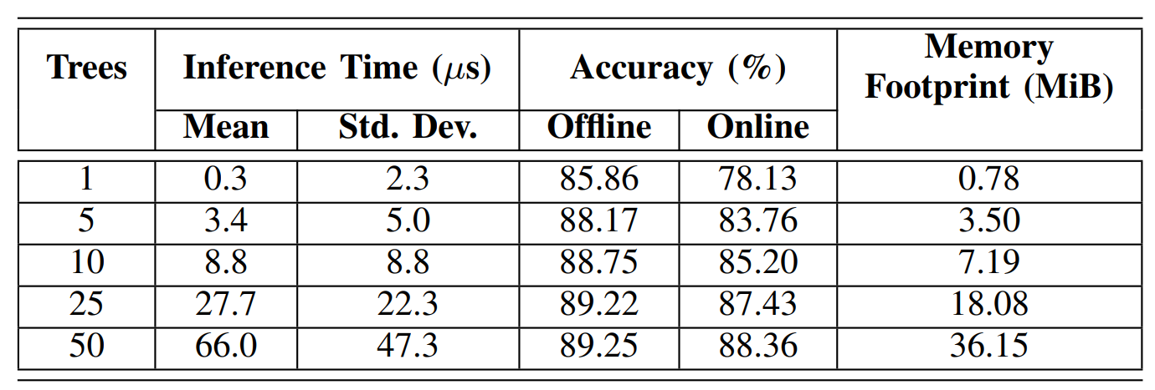
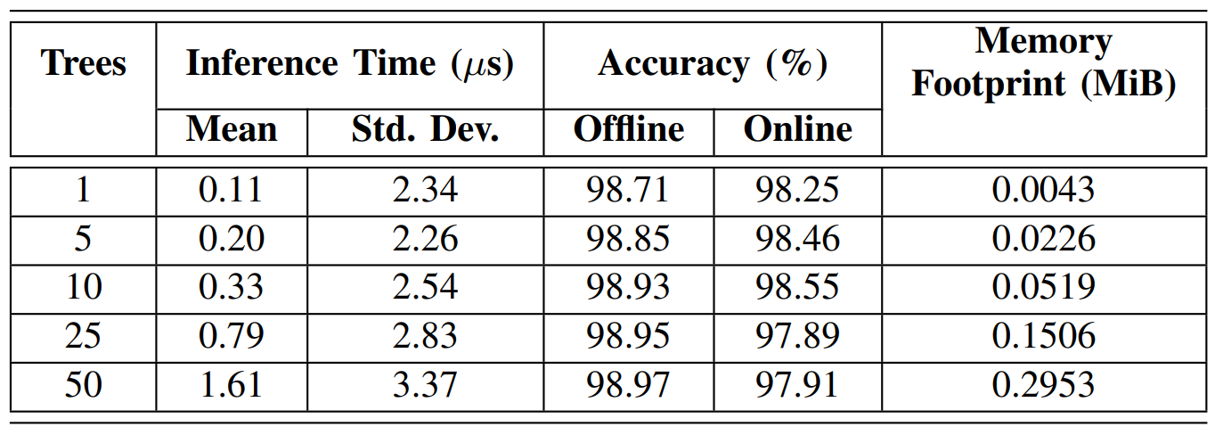
Accelerating Attack and Fault Detection in
Cyber-Physical Systems Using SmartNICs and DPDK
Samia Choueiri, Sergio Elizalde, Ali Mazloum, Jose Gomez, Elie Kfoury, Jorge Crichigno
University of South Carolina, Columbia, South Carolina
Abstract
System Architecture
Evaluating Accuracy and Separability
Cyber-Physical Systems (CPS) require real-time monitoring under strict latency constraints, where delayed detection can compromise system stability and reliability.
We propose a SmartNIC-accelerated anomaly detection framework for CPS that enables both fault detection (sensor and system failures) and attack detection (network-based anomalies).
The system performs flow-level feature extraction and Random Forest (RF) inference directly in the network data plane.
A pre-trained RF model is offloaded to an NVIDIA BlueField-3 SmartNIC, enabling in-network, low-latency classification of normal vs anomalous behavior.
We identify a lightweight feature set, optimal window size, and model configuration that balance detection accuracy with inference efficiency.
Experimental results show approximately 98% detection accuracy and less than 1 μs inference latency.
Results demonstrate that SmartNIC-based in-network ML enables efficient, real-time detection of both faults and attacks in CPS.
PLC-controlled industrial cells connected via an OT network to a SCADA server equipped with a SmartNIC. The SmartNIC includes programmable data-plane components used for high-performance packet processing.
Accuracy and ROC–AUC are used to evaluate classification performance and class separability for both fault and attack detection.
Fault detection is more challenging due to less separable and more variable patterns than attack traffic.
Model accuracy at different window sizes
Fault detection separability
Attack detection separability
Evaluating Feature Explainability
Evaluating Online Inference Time
SHAP analysis reveals key feature contributions for both fault and attack detection tasks.
Attack detection exhibits higher separability, with clearer feature contributions compared to fault detection.
Online inference time remains low across configurations, with latency increasing as the number of trees grows.
Fault detection required deeper trees for the model to perform well.
Related Work
Programmable data planes have been widely used in CPS to meet strict latency and security requirements. P4-based solutions enable high-speed, in-network processing and protocol validation, but are limited by hardware-specific constraints and reduced flexibility [1,2].
Machine Learning (ML) has previously been applied for attack detection in CPS using models such as SVMs and Random Forests [3,4]. While these approaches achieve high accuracy, they typically rely on centralized CPU-based processing, leading to increased latency and limited suitability for real-time environments.
[1] Samson Raj et. al., “Leveraging data plane programmability towards a policy-driven in-network security framework for industrial control systems,” 2025.
[2] Cesen et. al., “Offloading Robotic and UAV applications to the network using programmable data planes,” 2023
[3] Jan et. al., “A distributed sensor-fault detection and diagnosis framework using machine learning,” 2021
[4] Amiri et. al., “Faults detection and diagnosis of PV systems based on machine learning approach using random forest classifier,” 2024
CPS system architecture with SmartNIC
Methodology
(a)
(a)
The system follows a two-stage workflow, separating offline training from online in-network inference.
Offline phase: CPS network traces are processed on the host to extract flow-level features from Modbus traffic. These features are used to train an RF model to distinguish abnormal behavior.
Online phase: The model is offloaded to the SmartNIC and executed directly in the data plane using DPDK. Each incoming flow is evaluated multiple by decision trees, and the final prediction is obtained through majority voting.
(b)
(b)
Conclusion and Lessons Learned
Feature importance for (a) fault detection and (b) attack detection
Online inference time for (a) fault detection and (b) attack detection
SmartNIC-based framework enables real-time fault and attack detection in CPS.
High accuracy (> 98%) and microsecond-scale latency (< 1 μs) are achieved for attack detection using lightweight RF models (shallow trees).
SmartNIC offloading reduces CPU overhead while enabling efficient in-network inference.
Evaluating Offline and Online Performance
Attack detection achieves high accuracy with small trees (depth 8), while fault detection needs deeper trees (depth 32) to capture complex patterns.
Increasing the number of trees improves accuracy but incurs higher inference time and memory cost.
Fault detection
Attack detection
Acknowledgement
This work was supported by the National Science Foundation (NSF), Award 2417823, and 2403360.
Proposed framework

